Slide 1

Green Pace
Security Policy Presentation
Developer: C.J. Cline
Green Pace Proposed Security Policy

Slide 2

OVERVIEW: DEFENSE IN DEPTH
Notes:
Security Policy –
My recommended security policy is protective mindset focused on reducing errors and building aggressive defense, doing so requires a developers and users to take an active part.
The IT role involves making sure the company computers are up to date with the latest defensive layered protections, I.E. Firewall, Anti-Viruses and Communicating with users their roles.
Developers role involves maintaining clean data and creating pathways for a AAA – setting the parameters for Authorization, Authentication and Accounting. - They will do so by building username/password w/ with multifactor identification and maintaining logging procedures withing the company data

Slide 3
THREATS MATRIX
1st : Prevent attackers by validating users and using clean data.
2nd: Is to hold the code that does so accountable and account for all data transfers.
Likely Internal Errors/ Uncleaned Data | Priority SQL Injections/ Outside Attackers
Low Priority Test Your Cod/e Validate Security Assumptions | Unlikely Reduce Damages

Slide 4
10 PRINCIPLES
Validate Input Data
Heed Compiler Warnings
Architect and Design for Security Purposes.
Keep it Simple
Default Deny
Adhere to the Principle of the Least Privilege
Sanitize Data Sent to Other Systems
Practice Defense In Depth
Use Effective Quality Assurance
Adopt a Secure Coding Standard
Standards Utilization Reference
Standard 1 – Validate Inputs
Standard 2 – Default Deny
Standard 3 – Sanitize Data
Standard 4 – Validate Inputs
Standard 5 – Keep it Simple
Standard 6 – Quality Assurance
Standard 7 – Design for Security
Standard 8 – Sanitize Data
Standard 9 – Sanitize Data
Standard 10 – Adhere to Principle of Least Privilege
Notes:
In front of you I’ve provided the core principles of the code our the security policy recommendation, these ten steps on the left will act as guidelines for future policies as new needs arise.
The core ten standards focus on data keeping data that comes in clean, preventing attackers and when attacks do occur have a way to track what happened and limit the scope of the damage.

Slide 5
CODING STANDARDS(Priority Order)
Standard 1 High
Standard 2 High
Standard 4 High
Standard 8 High
Standard 9 High
Standard 5 Medium
Standard 6 Medium
Standard 7 Medium
Standard 10 Medium
Standard 3 Low
High Priority Standards – Involve keeping the data valid and clean to prevent malicious attackers out through input testing before entry.
Medium & Low Standard – Self validating and keeping our code understandable, the simpler a concept can be the less loopholes can be created from over-complexity.

Slide 6
ENCRYPTION POLICIES
Encryption in Flight - Data should be encrypted anytime it is in transit if that is over the internet, or in soft storage like a flash drive.
Encryption at Rest - Data should be encrypted when resting in the home servers, if malicious access occurs encrypting the data at that point can limit the scope of the damage.
Encryption in Use – The only time data should be unencrypted is when it is actually in use.

Slide 7
TRIPLE-A POLICIES
Authentication – Validate that the user is who they say they are.
Authorization – Limit the user in scope to what they need to do to accomplish their job.
Accounting – Record all actions that occur within the system.

Slide 8
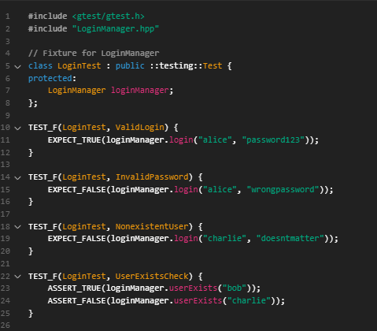
Unit Testing (Log In)
Primary example of the style of unit testing you would be implementing.
This involves,
Asserting True & False with both the expected and unexpected outcomes.

Slide 9
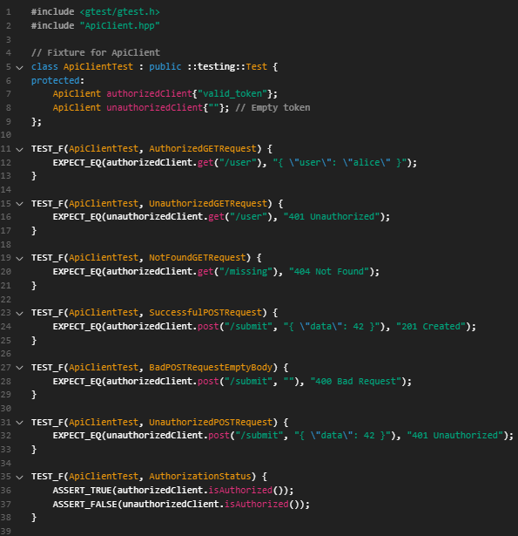
Unit Testing (API Access)
In this boiler plate example we can also detail the expecting specific goals when we want specific answers to test at a value.

Slide 10

AUTOMATION SUMMARY

Slide 11
TOOLS
https://rules.sonarsource.com/
Sonar source is a static analyzer that reads code as you write it and identifies vulnerabilities as you are writing. This will allow the developers to cleaner and safter code as they go and help in reducing problems in the code base. https://google.github.io/googletest/
Google Test is a unit test program similar to Junit but it created by google and with a focus on C++ rather than Java

Slide 12
RISKS AND BENEFITS
Benefits – The advantages of this strategy is that it provides robust defensive structures to preventing attackers and keeps the code back running smoothly and easy to understand.
Risk – The disadvantages is type of defense is reliant on the users and staff being vigilant and apart of the defense. If an authenticated user with high enough credentials , is handling malicious attack then It won’t prevent the attack.

Slide 13
RECOMMENDATIONS
The biggest gap in this security policy will be user implementation, with different employee individual emphasis and interest in security policy.
Maintain everyone onboard and working together and up to date will need to take priority if this is going to function best.

Slide 14
CONCLUSIONS
I would adopt the secure coding practices previously stated.
regular security trainings for the staff yearly, make them aware of new hacking attempts tried each year and which ones were successful.
A security review as yearly sprint for developers to update polices.

